Slide 1
Prologue:
The Software Process

Slide 2
Objectives
To review software process and its phases

Slide 3
Main Phases of Software Process
Requirements Analysis (answers “WHAT?”)
  Specifying what the application must do
Design (answers “HOW?”)
  Specifying what the parts will be, and how they will fit together
Implementation (A.K.A. “CODING”)
  Writing the code
Testing (type of VERIFICATION)
  Executing the application with test data for input
Maintenance (REPAIR or ENHANCEMENT)
  Repairing defects and adding capability

Slide 4
Software Process Phases:
Personal Finance Example
Requirements Analysis: Diagrams and text
  e.g., “ … The application shall display the balance in the user’s bank account. …”
Design: Diagrams and text
  e.g., “ … The design will consist of the classes CheckingAccount, SavingsAccount, …”
Implementation: Source code
  e.g., … class CheckingAccount{ double balance; … } …

Slide 5
Software Process Phases:
Personal Finance Example (Cont’d)
Testing: Test cases and test results
  e.g., “… With test case: deposit $44.92 / deposit $32.00 / withdraw $101.45 / … the balance was $2938.22, which is correct. …”
Maintenance: Modified design, code, and text
  e.g., Defect repair: “Application crashes when balance is $0 and attempt is made to withdraw funds. …”
  e.g., Enhancement: “Allow operation with Riyal.”

Slide 6
Key Concept: Software Process
A procedure followed by the development team to produce an application.

Slide 7
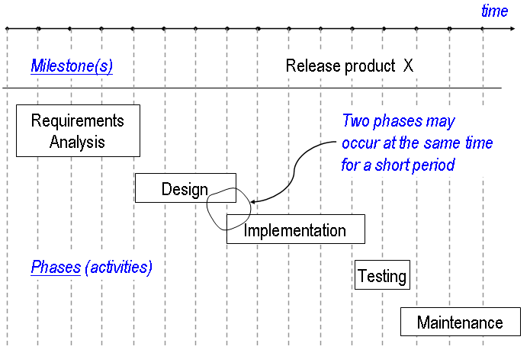
The Waterfall Software Process

Slide 8
Key Concept: Waterfall Process
Basic software process in which requirements analysis, design, coding, testing, and maintenance are performed in sequence, but with some overlap.

Slide 9
Why a Pure Waterfall Process is Usually Not Practical
Don’t know up front everything wanted and needed
  Usually hard to visualize every detail in advance
We can only estimate the costs of implementing requirements
  To gain confidence in an estimate, we need to design and actually implement parts, especially the riskiest ones
  We will probably need to modify requirements as a result
We often need to execute intermediate builds
  Stakeholders need to gain confidence
  Designers and developers need confirmation they're building what’s needed and wanted
Team members can't be idle while the requirements are being completed
  Typically put people to work on several phases at once

Slide 10
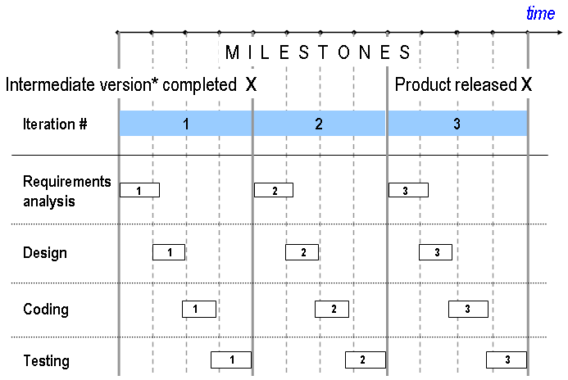
The Spiral Process

Slide 11
Key Concept: Work Against the Product of Prior Phase
In each phase of the software process, we design and code within the specifications produced by the prior phase.

Slide 12
Key Concept: Inspections
An artifact is a document or code.
An inspection of an artifact is the process of reading through the artifact in a complete and entirely thorough manner.

Slide 13
Key Concept: Requirements Analysis
The process of understanding what’s needed or wanted, and expressing the results in writing.

Slide 14
The Challenges of Requirements Analysis
Express requirements in ordinary, clear English
  Non-technical
  From the user’s perspective
Organize the requirements into logical groupings
  Make easy to access and change
  Challenging for real applications
Arrange for the management of requirements
  A procedure must be developed in advance for keeping the requirements documents up to date
    Who, how, and when

Slide 15
Design
The design of an application expresses how the application is to be constructed.
It describes the parts involved and how they are to assembled.
It consists of a set of documents (diagrams and text)

Slide 16
Tips on Coding
Code only against a design
Specify precisely what each method accomplishes
Before compiling, satisfy yourself that the code you have typed is correct. Read it thoroughly.
  ‘correct’ means that is satisfies what’s required of it
  This is “author-inspection”
Build-a-little-Test-a-little
  Add a relatively small amount of code (“build-a-little”)
  (Again): Read what you have typed and correct it if necessary until you are totally satisfied it’s correct
  Compile
  Test the new functionality (“test-a-little”)

Slide 17
Key Concept: Author-Inspect Before Compiling
Inspect and edit the block of code you have just written until you are convinced it does exactly what it is meant to do. Only then compile it.

Slide 18
Testing
The testing phase consists of supplying input to the application and comparing the output with that mandated by the software requirements specification.
Helps to uncover defects
Proves the presence of defects, but never their absence

Slide 19
Types of Testing
Unit Tests
  Tests on parts of an application (individual methods, classes, etc.)
System Tests
  Tests of an entire application
Black-box testing
  Compares the output obtained with the output specified by the requirements document
  Does not take into account the manner in which the application is designed
White-box testing
  Based on the design
  Exercise specific design features such as branching, loops, interfaces, etc.

Slide 20
Tips on Testing
Test early and often
Test with extreme values
  Very small, very big, etc.
  Borderline
  “Illegal” values
Vary test cases
  Don’t repeat tests with same test data except when specifically intended

Slide 21
Key Concept: Testing
Test early and often: Note that “passed all tests” doesn’t equate to “bug free.”

Slide 22
Maintenance
Maintenance refers to the work performed on the application that occurs after it has been delivered.
Types of maintenance
  Corrective (Defect Removal)
    Finding and fixing all inconsistencies with the requirements document
  Perfective (Enhancement)
    Introducing new or improved capability
  Adaptive
    Adapts software to new environment
  Preventive
    changing some aspect of the system to prevent failures

Slide 23
Summary of Software Process
A way of going about the creation and upkeep of a software product
Commonly based on the Waterfall process
  Specify requirements
  Create design
  Write code
  Test
  Maintain
In sequence with some overlap

